Slide 1
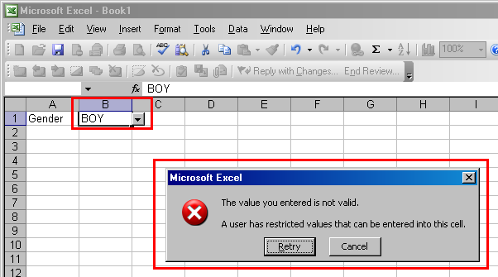
Managing Data Quality
Validation is a process where data is checked at the point that it is input to the database.
If users input incorrect data, screen prompts appear to inform the user of the incorrect data entry.
Validation on a spreadsheet

Slide 2
Managing Data Quality
Validation Checks
Data type check – e.g., numbers cannot be input to a text field or if a date is input, the software will prompt if it is not a valid date.
Range Check – e.g., for order entry, item quantities may be restricted to a range of numbers, perhaps, 1 to 100, if appropriate.
Presence Check – a particular field may be a required field, e.g., a person's last name.

